Slide 1

IST 687 Final Project
Can we predict when a person will quit their job?
Group 3: Ryan Tervo, Christian Dobish, Blake Tindol, Keegan Conroy, Leonard Lasek

Slide 2
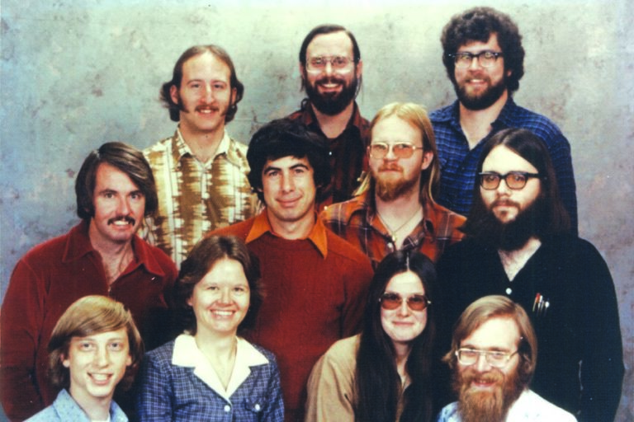
Team Members
Christian Dobish
Leonard Lasek
Blake Tindol
Ryan Tervo
Keegan Conroy

Slide 3

Project Guidelines
Brief description of the project and its objectives

Slide 4
Objective
In a step-wise fashion, employ data science techniques to a dataset that consists of employee statistics and survey data. We will attempt to construct a model using the techniques learned this semester to predict the attrition rate at IBM. We hope to build a model that fully leverages the relationships inherent in the data. This will involve trying multiple models and using some data science techniques to select the variables most meaningful to the end goal.
Selecting a Dataset
Guidelines
The team will have to pick a dataset to be analyzed.
The dataset needs to have a minimum of 10,000 “values” (ex. a dataset with 10 attributes and 1,000 observations).
The dataset does not have to be publicly available.
There are no required questions to be addressed, or techniques to be used. However, the team is expected to use advanced data science concepts, and not just traditional descriptive statistics.

Slide 5
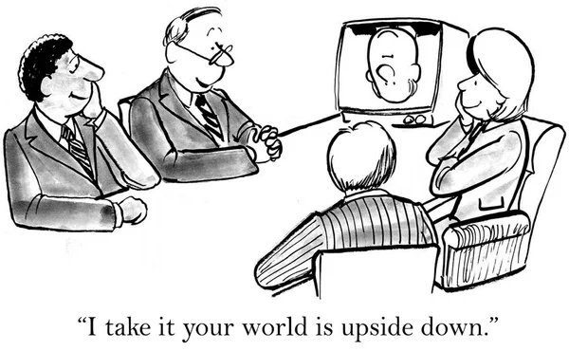
Business Understanding
What is the business purpose for analyzing this data set?

Slide 6
Business Understanding
Why are employers concerned about attrition?
All employers would like to reduce the attrition rate as much as possible. Attrition can have rippling effects across the culture and reputation of a firm, but it also has implications for the productivity and profitability of the company.
How can we better understand attrition?
Attrition is a common and expected phenomenon for any company and is generally misunderstood. By collecting and analyzing the right data, we can begin to build some understanding of when and why people choose to leave a company.
What are the real-world applications of a predictive model?
Often it is something as simple as another employer was willing to pay more. If we could predict when an employee was going to leave before that person begins looking for new employment, then we might be able to keep better employees for longer. Answering this and related questions will help reduce dips in productivity and bolster the company moral and culture.

Slide 7

Data Understanding
What does the data look like?

Slide 8
Dataset
We chose the following dataset available off Kaggle.com
https://www.kaggle.com/datasets/pavansubhasht/ibm-hr-analytics-attrition-dataset
It is a fictional dataset created by data scientists at IBM.
The data is fairly large with 1,470 rows by 35 columns for a total of 51,450 data points. As the next slide shows the data is a mix of categorical and numerical data.
The mix of categorical data with numeric data presents various challenges as far as which statistical methods we can employ to analyze the dataset.
Our outcome variable Attrition is a binary categorical variable, specifically, "Yes" for did quit and "No" for did not quit.
We will use a logistical model and a "test of importance" to pinpoint the variables needed for the shrewdest model.
Organizing and prepping the data for analysis the most time-consuming aspect of and data science project but is of utmost importance. If our data is not in the proper condition our results could be wildly off and unusable.
We have chosen a "clean" dataset, but we will walk through a couple preprocessing steps to make sure.

Slide 9
Variables
A snapshot of the different data collected displayed by field name, data type and a sample of the data. For the analysis we will need to refactor the character data.
FIELD | TYPE | SAMPLE DATA | FIELD | TYPE | SAMPLE DATA
Age | num | 41 49 37 33 27 32 59 30 38 36 | MonthlyIncome | num | 5993 5130 2090 2909 3468
Attrition | chr | "Yes" "No" "Yes" "No" | MonthlyRate | num | 19479 24907 2396 23159 16632
BusinessTravel | chr | "Travel_Rarely" "Travel_Frequently" | NumCompaniesWorked | num | 8 1 6 1 9 0 4 1 0 6
DailyRate | num | 1102 279 1373 1392 591 | Over18 | chr | "Y" "Y" "Y" "Y"
Department | chr | "Sales" "Research & Development" | OverTime | chr | "Yes" "No" "Yes" "Yes"
DistanceFromHome | num | 1 8 2 3 2 2 3 24 23 27 | PercentSalaryHike | num | 11 23 15 11 12 13 20 22 21 13
Education | num | 2 1 2 4 1 2 3 1 3 3 | PerformanceRating | num | 3 4 3 3 3 3 4 4 4 3
EducationField | chr | "Life Sciences" "Life Sciences" "Other" | RelationshipSatisfaction | num | 1 4 2 3 4 3 1 2 2 2
EmployeeCount | num | 1 1 1 1 1 1 1 1 1 1 | StandardHours | num | 80 80 80 80 80 80 80 80 80 80
EmployeeNumber | num | 1 2 4 5 7 8 10 11 12 13 | StockOptionLevel | num | 0 1 0 0 1 0 3 1 0 2
EnvironmentSatisfaction | num | 2 3 4 4 1 4 3 4 4 3 | TotalWorkingYears | num | 8 10 7 8 6 8 12 1 10 17
Gender | chr | "Female" "Male" "Male" "Female" | TrainingTimesLastYear | num | 0 3 3 3 3 2 3 2 2 3
HourlyRate | num | 94 61 92 56 40 79 81 67 44 94 | WorkLifeBalance | num | 1 3 3 3 3 2 2 3 3 2
JobInvolvement | num | 3 2 2 3 3 3 4 3 2 3 | YearsAtCompany | num | 6 10 0 8 2 7 1 1 9 7
JobLevel | num | 2 2 1 1 1 1 1 1 3 2 | YearsInCurrentRole | num | 4 7 0 7 2 7 0 0 7 7
JobRole | chr | "Sales Executive" "Research Scientist" | YearsSinceLastPromotion | num | 0 1 0 3 2 3 0 0 1 7
JobSatisfaction | num | 4 2 3 3 2 4 1 3 3 3 | YearsWithCurrManager | num | 5 7 0 0 2 6 0 0 8 7
MaritalStatus | chr | "Single" "Married" "Single" "Married"

Slide 10
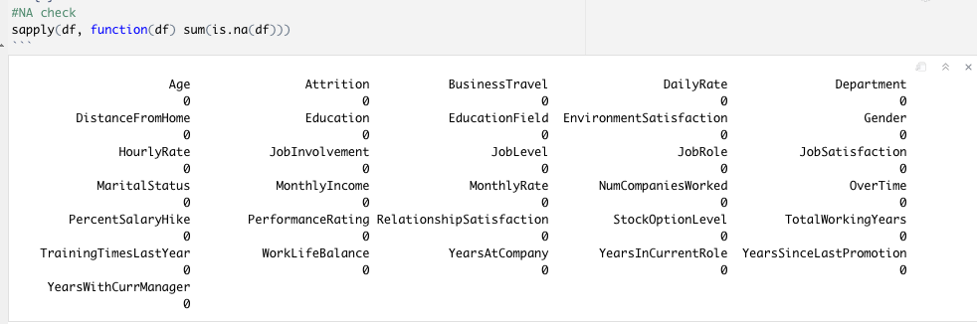
Data Clean Up
We will remove irrelevant columns: 'EmployeeCount','EmployeeNumber','Over18','StandardHours'
Next we will check for NAs:
Fortunately, our dataset was provided to us without NAs so no interpolated methods need to be employed.

Slide 11
Prior Intuition
Our prior intuition about the dataset will not only help steer our analytical process but will also help us judge the quality of the results. If a relationship emerges that seemed very unlikely, then this would demand some further investigation.
At first glance it looks as though males quit at a higher rate than females. On the next slide we will investigate this potential relationship further.
Longterm employees are likely to be loyal, and less likely to quit
We are interested in investigating the 237 out of 1,470 people who quit.
We expect the following four variables to be impactful to an employee's decision to stay
Job Satisfaction
Monthly Income
Business Travel
Job Level
The question remains if these 4 variables will play a role in our models or if some unexpected variables will play a larger role.

Slide 12
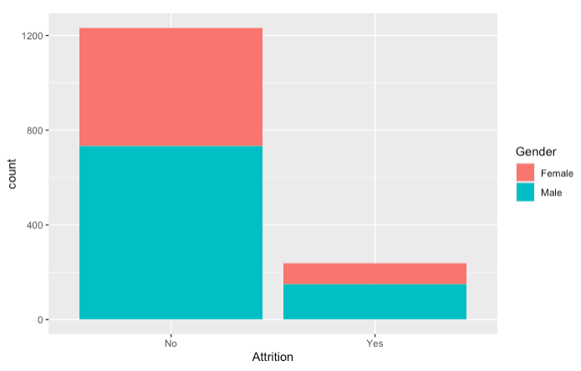

Visualizations
Attrition overall split by gender:
At first glance it looks as though males quit at a higher rate than females. On the next slide we will investigate this potential relationship further.
We are interested in investigating the 237 out of 1,470 people who quit.

Slide 13
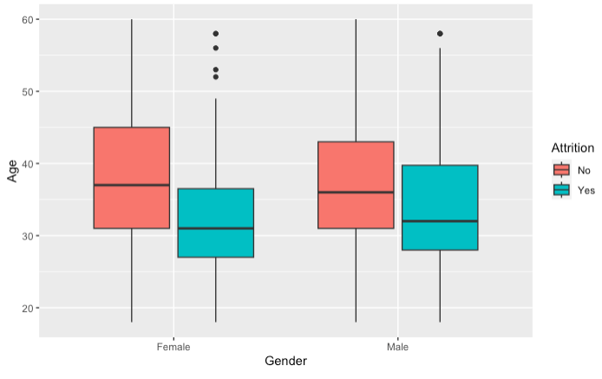
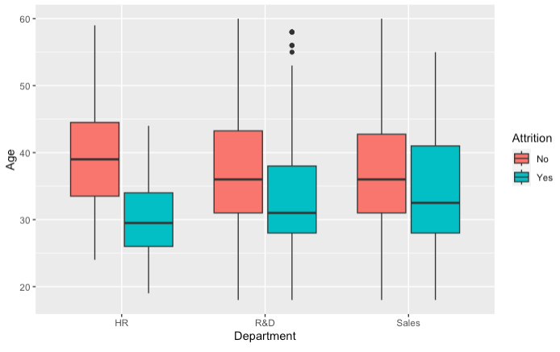
Visualizations
As the chart on the left shows, we do not appear to see much difference in the average level of attrition between the genders. For males there appears to be more variability across age than there is for females.
Both these visualizations capture the impact that Age has on Attrition. Broken out by Gender on the left and Department on the right, the average Age of those who quit was lower than those that did not. Based on this we would expect Age to be a key element in our prediction model.
We can also discern from the chart on the left that there appears to be no difference male or female on who quits.
Lastly, it appears that Sales has more variability in the ages of those who quit.

Slide 14
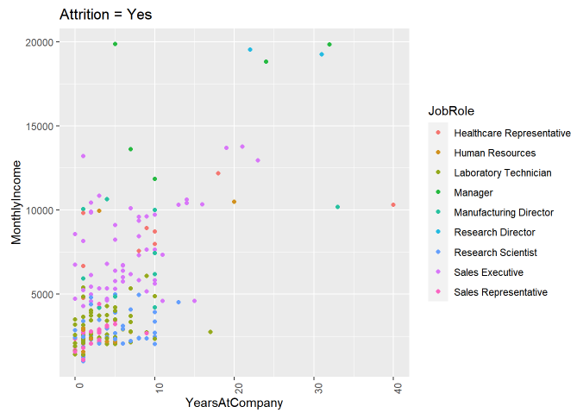
Visualizations
Attrition broken out by Monthly Income and Years At Company:
Looking at the data from a macro level we wanted to see if any other interesting patterns would emerge.
Employees with lower monthly income and fewer years working at the company have a higher amount of attrition. Laboratory Technicians have a higher rate of attrition. More than any other job role. Directors and Executives are least likely to quit.

Slide 15
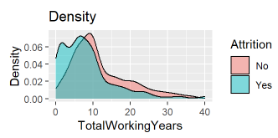
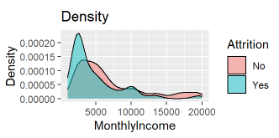
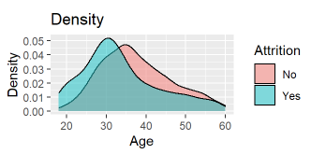
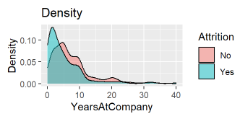
Visualizations
Density plots provide a probabilistic look at how the data is distributed.
Building upon our intuition about age playing a predictive role in attrition, the above charts reinforce this claim.
The density plots for TotalWorkingYears , MonthlyIncome, and YearsAtCompany, all heavily skew right for those who quit. This makes sense conceptually and is consistent with our intuition that younger people would be more prone to quit.

Slide 16
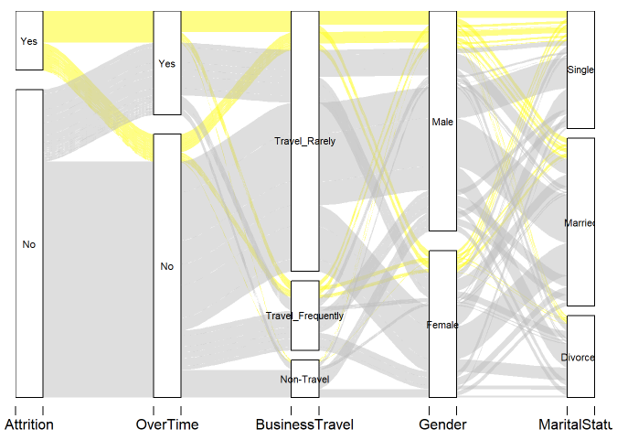
Visualizations
This is an plot created using the Alluvial Library in R.
By tracking the flows we can get a better intuition on how the parameters or predictor columns are connected
This plot says if you end up leaving a company you are likely to be split pretty evenly between having overtime or not, likely to not travel much, be a male and single.
If you not leaving you likely don’t get overtime rarely travel and are evenly split between genders and marital status.

Slide 17
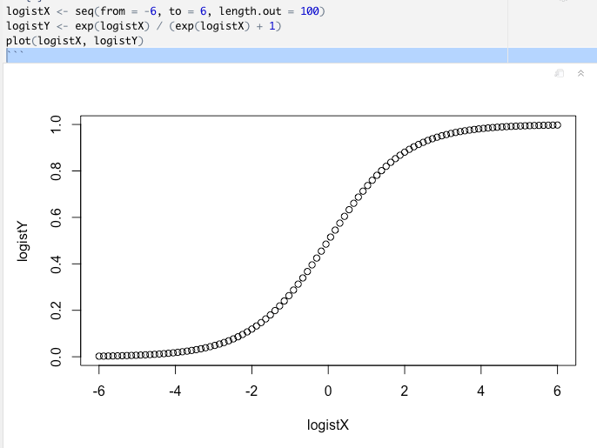
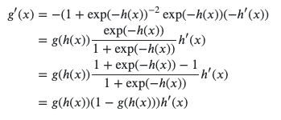
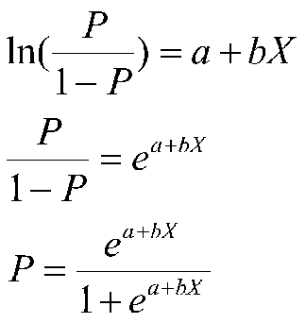
Models
A review of the models used in the analysis

Slide 18
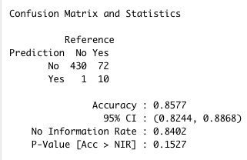
Initial SVM Model: Results
Support Vector Model (SVM)¹
A support vector machine (SVM) is a type of supervised learning algorithm that can be used for classification or regression. The goal of an SVM is to find the best dividing line (or hyperplane) that separates the data into classes. This line is known as the decision boundary. SVMs are particularly useful when the data is not linearly separable, which means that it cannot be separated into classes using a straight line. In these cases, the SVM uses a technique called the kernel trick to transform the data so that it can be separated using a non-linear boundary.
Results
With 85.8% accuracy, the SVM is only marginally better than the 84% No Information Rate.
We will rerun the model but with fewer variables next and compare our results. We will rely on a method known as the test of importance choose the variables.
No Information Rate (NIR)
The NIR is a measure of the baseline accuracy that can be achieved by a classifier without any information about the data. In other words, the NIR is the probability that a random guess will be correct.
¹https://towardsdatascience.com/support-vector-machine-introduction-to-machine-learning-algorithms-934a444fca47

Slide 19
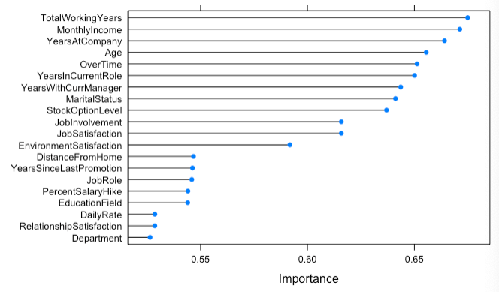
Eliminate Variables: Test of Importance
Test of Importance¹
The variable importance method is a way of measuring the importance or contribution of individual predictors (variables) in a model. In other words, it is a way of ranking the variables based on their ability to predict the outcome. There are many different ways to calculate variable importance, and the specific method used can depend on the type of model and the data.
Learning Vector Quantization (LVQ)
It is a type of unsupervised learning algorithm that can be used for clustering or classification. LVQ is a variation of the k-means clustering algorithm.
Results
The top 20 variables ranked for importance are shown.
Recall the variables we plotted that showed visual significance. All of those variables are included here in these results.
We will rerun the model but with fewer variables next and compare our results. We will rely on a method known as the test of importance choose the variables.
¹ https://topepo.github.io/caret/variable-importance.html

Slide 20
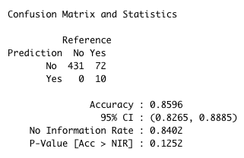
Final SVM Model: Results
Results
With 86% accuracy, the SVM is again only marginally better than the 84% No Information Rate. This also predicted all the No's correctly.
It's also worth noting that this model is producing the same level of accuracy as the initial model which contained all of the data. The confusion matrix is slightly different. The upshot is that we will opt to use the smaller dataset as we pursue other types of predictive models.

Slide 21
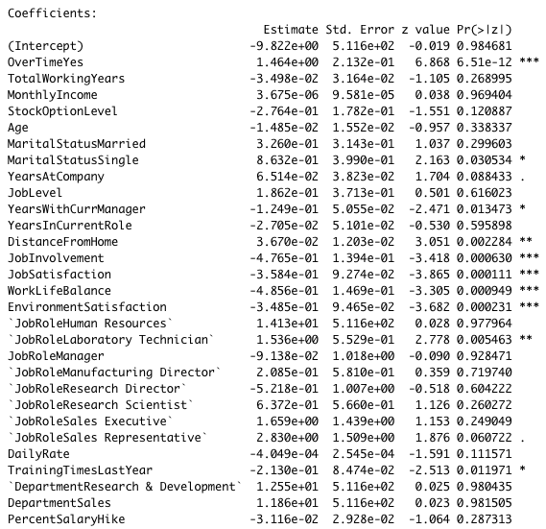
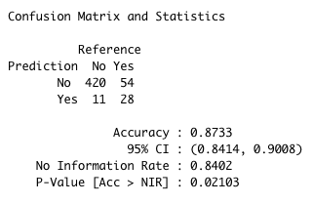
Logistical Regression
Results
We used the R glm() function to fit the data to a generalized linear model using the "logit" distribution. We ran the model with all of the variables. We then extracted only the significant variables and re-ran the model. This yielded the results to the right.
The estimates are referred to as the log-odds. Since that is difficult to conceptualize, we transform the estimate by raising 'e' to that value. Taking Overtime as an example, we see an exponential of 4.32. This means that the odds of quitting are 4.32 times more likely when Overtime moves from zero to one, i.e. from No to Yes.
Confusion matrix
The accuracy of this model is strongest so far at 87.3%

Slide 22
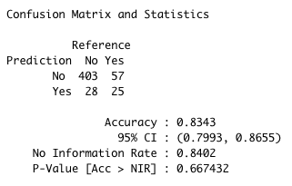
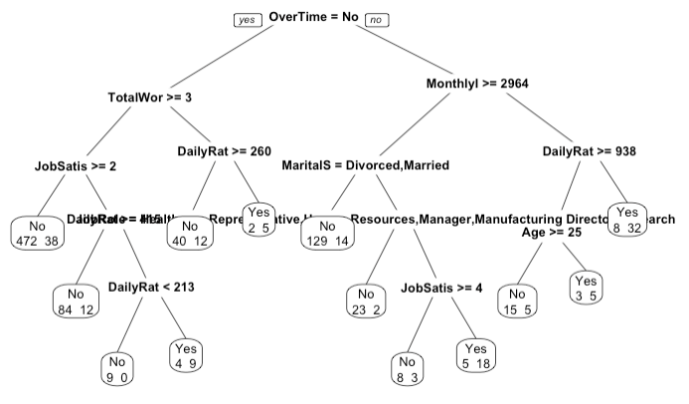
Decision Tree using 'rpart' Library
rpart Library
The rpart library is a package for the R programming language that provides functions for fitting recursive partitioning models. Recursive partitioning is a method of building decision trees, which are used for classification and regression.
Results
A reduction in accuracy to 83.4% is worse than the No Information Rate of 84%. This is also a worse result than the SVM model.

Slide 23

Evaluation & Deployment
How effective are the models?

Slide 24
Model Comparison
 | No Information | SVM | Decision Tree | Logistic
Accuracy | 84.02% | 86% | 83.4% | 87.3%
Rank (1 to 4, best to worst) | 3 | 2 | 4 | 1
Correct "Yes" rate | 0% | 12.2% | 34.1% | 34.2%
Correct "No" rate | 100% | 100% | 93.5% | 97.4%
Prediction Categories:
No - Staying with the company: Models Prediction Virtually Identical.
Yes - Leaving from the company: Logistic Regression clearly performed the best!

Slide 25
Deployment
The Logistic Model Has Value and Can Assist in Identifying those "Most at Risk" of Leaving:
Overall the model takes into account risk factors and can flag individuals at risk.
This gives leadership, management and supervisors the opportunity to impact the attrition rate.
Recommendations Moving Forward:
1) Management and Supervisors should be informed of those "most at risk" and the risk factors, slide 19
2) Run Logistic Model Quarterly
Identify new "at risk employees" and work with management to address.
3) Retrain the Model Annually
Conditions can change over time, need to ensure the model remains current... avoid model drift.

